Slide 1
Binary Patch Transplant
Omkar Bhat, Jack Verrier, Zoya Yeprem

Slide 2

Approach
Automatically transplanting patches is an active research area
First steps:
Manually transplant patches
Compare two binaries using vbindiff
Compare two binaries in Ghidra Version Tracking
Learn what really changes in binaries
Currently: Patching a production binary in the wild.
Gnu Coreutils LS
Assumptions
Binaries are not stripped
No optimization
Linux infrastructure
Patch is as simple as possible
Notes:
Why these assumptions?
Binaries used are unstripped to give us access to information like function name …… which are useful when finding the location for the patch to be transplanted.
Patch is assumed to be simple because introduction of a single condition like if adds a few lines of code in the binary. Add a few lines of code means that we need to handle multiple things like basic increase in size of binary because of increase in size of patched funcion, changing the relative address as well as the function locations and data locations. We also need to modify the ELF Headers accordingly and make sure that new lines of code does not overwrite any part of the code.
Linux Environment for the ease of analysis.
If optimization is turned on the compiler, it might show us optimized binaries which have a few modifications for faster runtime which might be treated as false positives for our analysis.

Slide 3
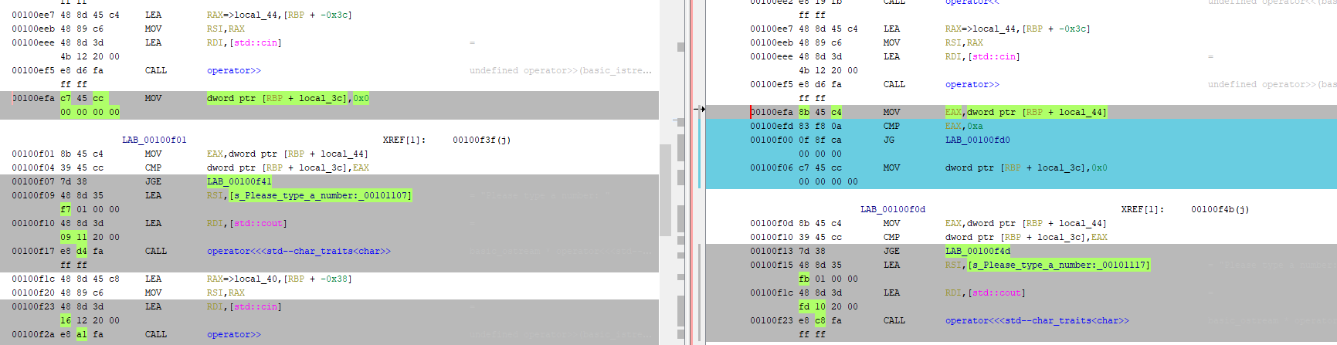
Manual Patching a Toy Binary
<< Screenshots here >>
Without Length Check
With Length Check

Slide 4
What does the patch affect?
Patching means applying changes to the code in order to:
Improve functionality
Remove a vulnerability in the code.
This can lead to various problems like:
Change in data memory locations
Change in indirect address
Change in function address and size
Change in Headers
Introduction of Branches
Changes in alignment
Notes:
Should we add that removing stuff is easier as we can just add nop in their place, but for adding we need to worry about a lot of other things

Slide 5
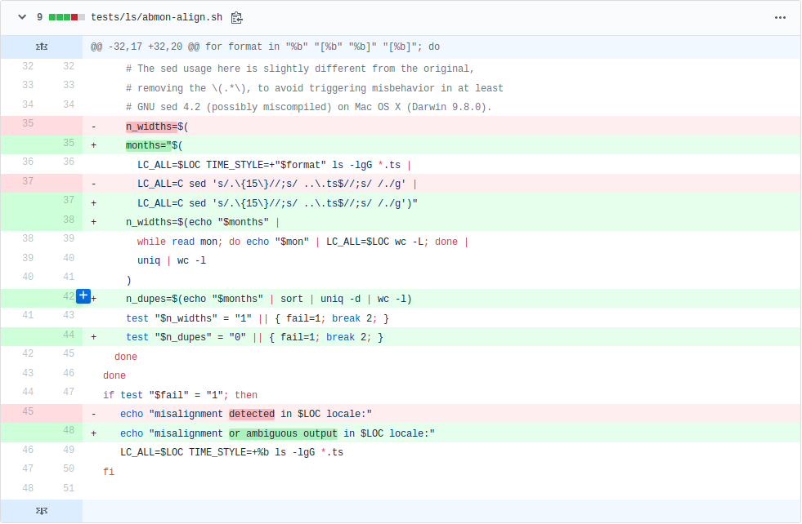
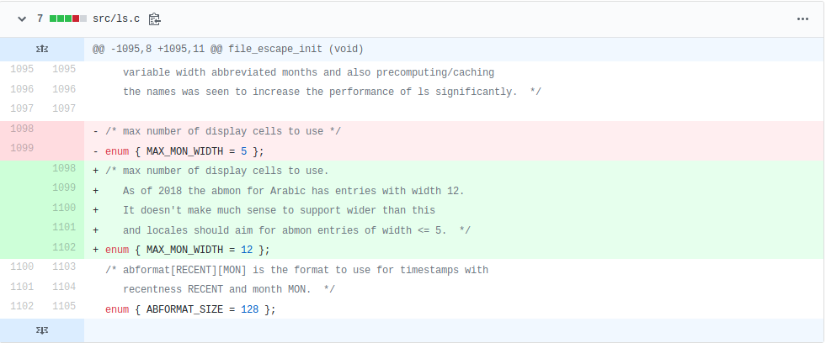
Patching a Real World Binary
Gnu Coreutils LS (March 16th, 2018 patch):
Binary: 623.7 kb. Source Patch: 13 additions, 5 deletions
Binary Patch: ~600 bytes
Status:
In progress
Notes:
Can you explain this

Slide 6

Challenges
Updating indirect address, jump, function address, size and alignment
Changing things* in the Header section
Active Research Area
* Things like version, entry point address flags , size of section headers, size of program headers, start of the program headers.
Notes:
*Things like version, entry point address flags , size of section headers, size of program headers, start of the program headers.

Slide 7
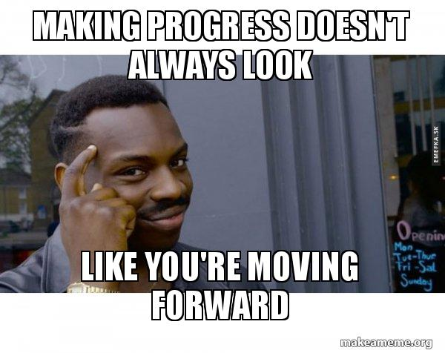
Moving Forward
Compare unpatched real world binaries and get a function with vulnerability to patch
Look at how to update all the tables
Modify ELF Headers
Use what we have learned to successfully apply patches

Slide 8
Questions
?
Notes:
Yonghwi’s comments:
Try doing a patch in a better way, with less impact on the binary.
Sometimes a change in the source is having it’s biggest impact on binary metadata.

